Slide 1
Data Warehouse
A data warehouse is a relational or multidimensional database management system designed to support management decision making.
It is constructed by integrating data from multiple heterogeneous source.
It supports analytical reporting, structured and/or ad hoc queries and decision making.
Data warehouse provides OLAP (Online Analysis Processing)

Slide 2
Data Warehouse
A data warehouse is a database, which is kept separate from the organization's operational database.
There is no frequent updating done in a data warehouse.
It possesses consolidated historical data, which helps the organization to analyze its business.
A data warehouse helps executives to organize, understand, and use their data to take strategic decisions.

Slide 3
Why Data warehouse is separated from operational Database ?
An operational database maintains current data. On the other hand, a data warehouse maintains historical data.
An operational database is constructed for tasks such as searching particular records, indexing, etc. In contrast, data warehouse queries are often complex and they present a general form of data.
Operational databases support concurrent processing of multiple transactions.
An operational database query allows to read and modify operations, while an OLAP query needs only read only access of stored data.

Slide 4
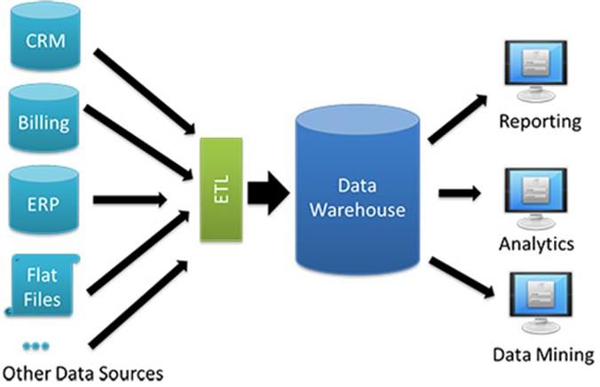

Slide 5
Advantages
Effective decision making
Better enterprise intelligence
Enhanced customer service
Business Reengineering
Simplified data format
Non-volatile data
Data retrieval is possible without slowing down the operational system.

Slide 6
Components of Data Warehouse
Summarized Data
Current Detail
Operational system of record
Integration/Transformation Record
Archives
Metadata

Slide 7
Uses of Data Warehouse
Standard reports and queries
Queries against summarized data
Data Mining

Slide 8
Data Mining
It is a process of extracting hidden patterns from data.
It is a process by which raw data can be turned into useful information.
Also known as Knowledge Discovery.
It can be applied to data sets of any size.
It is widely used in profiling practices such as marketing, fraud detection, scientific discover etc.

Slide 9
Steps in Data Mining
Data Cleaning : remove inconsistent data
Data Integration : integrate/compile multiple data
Data Selection : Data relevant to analysis is selected
Data Transformation : summary normalization aggregation operations are performed(convert data into 2-D form) & consolidate data

Slide 10
Functions of Data Mining
Classification : infers the defining characteristics of a certain group
Clustering : identifies groups of items that share a particular characteristics
Association : identifies relationships between events that occur at one time
Sequencing : similar to association, except that the relationship exists over a period of time
Forecasting : estimates future values based on patterns within large sets of data

Slide 11
Data Mart
Data Mart is a subset if an enterprise-wide Data Warehouse, which typically supports an enterprise element (department, region).
The goal of a data mart is to meet the particular demands of a specific group of users within the organization, such as human resource management

